Slide 1
MIS 321
Decorator Design Pattern

Slide 2
The Problem – How would you solve this today?
Local pizza chain would like help with their point of sales system.
The base cost of a pizza is based on the type of the pizza (original, deep dish, stuffed crust).
From there each topping is $1 extra
Toppings include:
Cheese, pepperoni, sausage, veggies
Customers can add multiples of toppings. i.e. double cheese, double pepperoni

Slide 3
Simplified Design Principle
Question – What happens when we add extra toppings in the future?
Classes should be open for extension, but closed for modification
Question – Could you satisfy this principle with your current solution to the problem?

Slide 4
Decorator / Wrapper Design Pattern
Decorator Pattern attaches additional responsibilities to an object dynamically. Decorators provide a flexible alternative to sub classing for extending functionality.

Slide 5
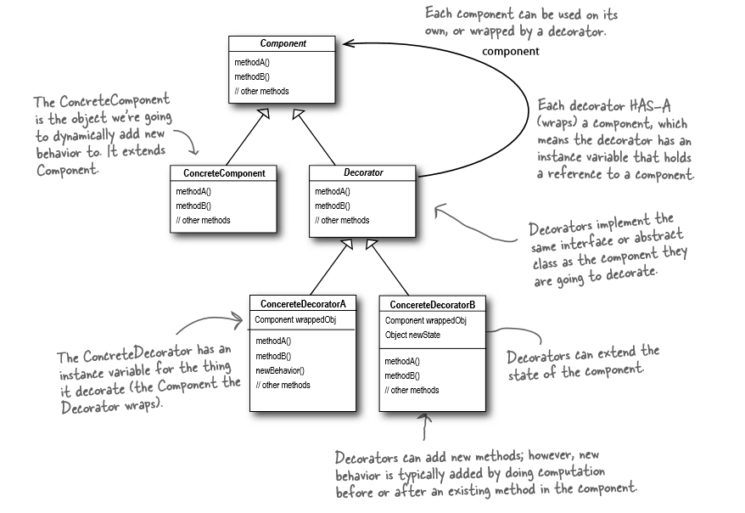
Decorator Pattern

Slide 6
Decorator
1) Let’s start with a pizza and the base cost
Cost()
Pizza
2) Let’s add cheese by creating a Cheese object and wrap it around the pizza
Cost()
Cheese
Cost()
Pizza
3) Let’s add peperoni by wrapping the cheese object
Cost()
Peperoni
Cost()
Cheese
Cost()
Pizza

Slide 7
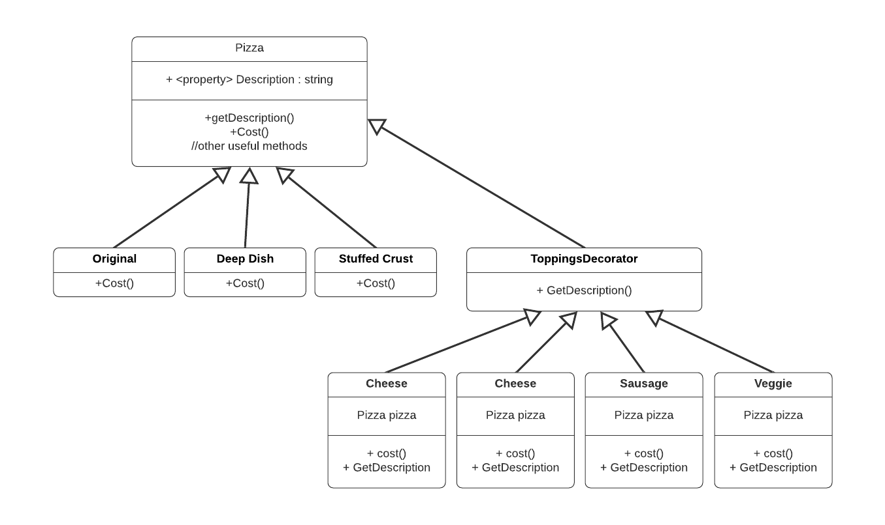
Pizza Problem UML

Slide 8
Advantages
Open for modification without changing base classes
Responsibilities are added to an object dynamically, circumventing the drawbacks of subclassing
Easy to customize

Slide 9
Disadvantages
Many little objects which may appear to all look alike
Can be very difficult to debug
Can complicate the process of instantiating a component because you also have to instantiate the wrappers

